Slide 1
COBOL
By Lee Beadle

Slide 2
What is COBOL?
Acronym for Common Business-Oriented Language
The first major programming language designed specifically for business and data applications
Third-generation programming language
Language paradigm:
Imperative
Procedural
OOP (2002)

Slide 3
Design Influences
FLOW-MATIC Data Processing Language (1957)
Grace Hopper
Only designed for UNIVAC machines
COMTRAN Language (1957)
Commercial Translator
Designed only

Slide 4
History
Designed in 1959 by CODASYL
Conference of Data Systems Languages
IBM
RCA
Sylvania
U.S. Department of Defense

Slide 5
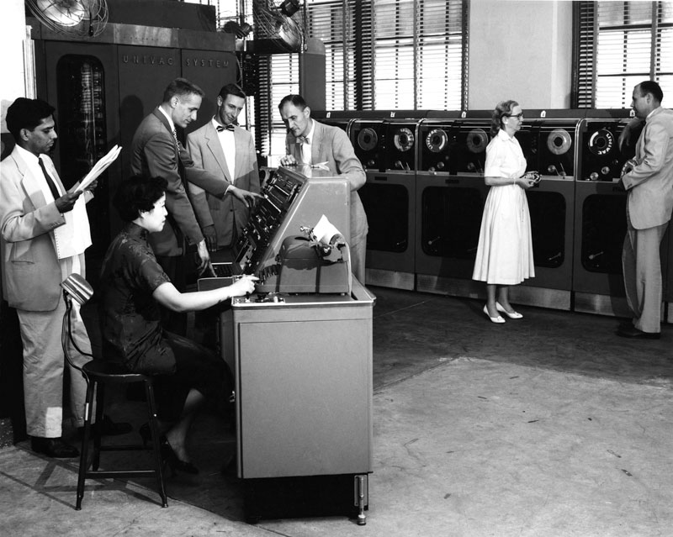
History Continued…
1960
COBOL program works on the UNIVAC II and RCA machine
1961
COBOL-61
Minor revisions
1968
COBOL-68 ANSI approved

Slide 6
Major Features
Readability
“English-like” syntax
Self-documenting
Robust
Large number of tools to process and manipulate large volumes of data
Portability
“Machine Independence”
Compatible with previous versions

Slide 7
Disadvantages
Wordiness
Reserved words
Design
Criticized by computer scientists and mathematicians
High number of different dialects
Only original author can interpret
Y2K involvement

Slide 8
Current Status and Legacy
COBOL use declined in 1990s but still heavily used today
According to The Next Web News
80% personal transactions
95% ATM transaction
Why?
Financial institutions with 1970s based infrastructure
Cheap
The next 20 years

Slide 9
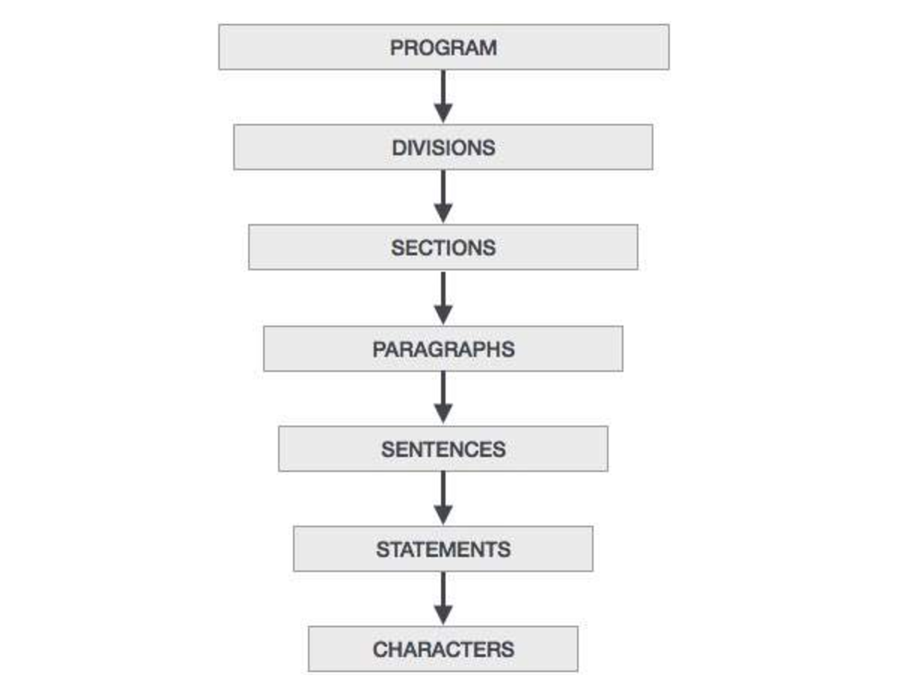
COBOL Program Structure

Slide 10
Divisions
Identification
Mandatory
Environment
Specifies I/O and machine
Data
Variables
Procedure
Logical, executable statements
One statement

Slide 11
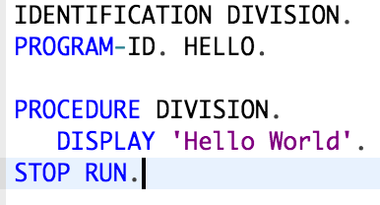
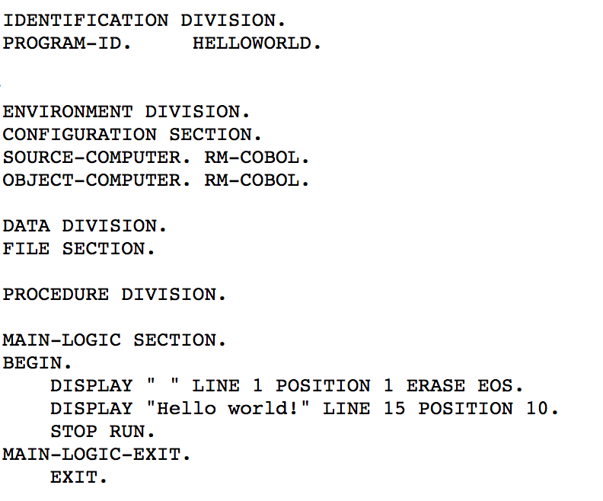
Hello World

Slide 12
References
CNN
http://www.cnn.com/TECH/computing/9906/09/1959.idg/index.html
Smithsonian
http://americanhistory.si.edu/cobol/proposing-cobol
The Next Web
https://thenextweb.com/finance/2017/04/10/ancient-programming-language-cobol-can-make-you-bank-literally/
Tutorials Point
https://www.tutorialspoint.com/cobol/cobol_overview.htm

